Slide 1
Hackers Doing Homework
Alex Minster

Slide 2
>whoami
Technical Security Analyst
Offensive Security Minded
My card says Curious. *******. Hacker.
Adversaries do not play fair. I tend to also not play fair.
Shoutout to my mini-hackers (aka kids)

Slide 3
>id
Member of DC414, Milwaukee Area Hackers
Information security field for over 10 years
Penetration tester for 2 years
Completed training on Hacker Tools, Techniques, and Exploits

Slide 4
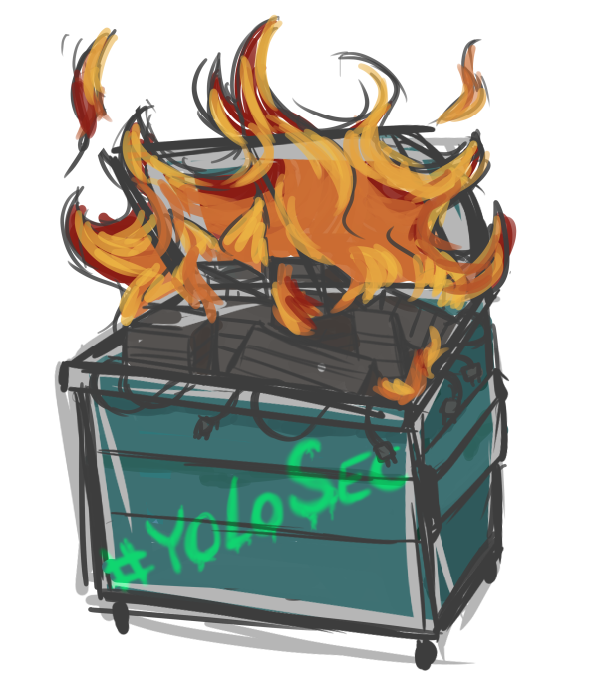
>gedit disclaimer.txt
Most examples will just be from Google images, and not directed at anyone. If you think I am talking about your organization…
These slides will be image and joke heavy, it keeps everyone’s attention. Also helps because:
Current state can be depressing

Slide 5
>gedit disclaimer.txt
Here as a representative of a “hacker”, and not representative of $employer
“I’m not here to call your baby ugly, I’m here to make sure the crib is safe.”
Notes:
Talking about security flaws and how exposed organizations are makes some people really uncomfortable.

Slide 6
>man hacker
White hat vs black hat vs grey hat
What shade am I, what shade are you?
Do you crack password hashes in your organization?
You should, and this is an example of doing things that are just a little bit grey.
Slide titles so far have been linux commands
Notes:
You are cracking passwords to make sure your technical controls work. Not to punish those with weak passwords. Strong passwords, and unique passwords, support non-repudiation. Also recommend cracking OLD passwords, not current ones. You are validating that your technical cotrols work. Or, if you get hashes, sit on them for 3 months, and then crack them. You do not want to have a scenario where security team, domain admin, help desk (who can access your computer, or where you store the cracked passwords) all know the password. How can you prove that things done with that password were done only by that user? Discussion of password cracking is a little outside the scope of this talk, but shows that we need to be a little grey.

Slide 7
>vi whythistalk.sh
Why did I select this topic?
Why did you decide to attend this?
Notes:
I had the thought in summary, of attacks with some semblance of pre-planning or good reconnaissance being waived away as “hackers somehow figured it out” and “hackers must have done their homework. Hackers really do have a payoff for doing good research and getting in. It is worth the additional pre-planning.

Slide 8
OSINT
Open Source Intelligence
Cyberstalking with a better name
The more you know about somebody, the easier time you will have in convincing them to click a spearfish.

Slide 9
OSINT
Let’s talk free
Or cheap
Or shared
And with a light touch, which makes defenses difficult.
Notes:
This is where hackers are beating most companies. They have no problems using a commercial tool, because if they paid for it, it was likely not with their money, and they are sharing it around. More on shared access later.

Slide 10
Whois
Used to gather contact names, DNS information, other data
Can start at internic.net/whois.html
Then dig to the domain registrar’s site (Like Network Solutions or GoDaddy)
GDPR changed this a little, but we’re still finding a lot of data out there
Notes:
I have seen where the name, and the e-mail address of the admin is disclosed, routing directly to an IT e-mail address. Additionally, if it is discovered that the e-mail is firstname.lastname@company.com, then the attacker now knows how to form their e-mails for additional intelligence.

Slide 11
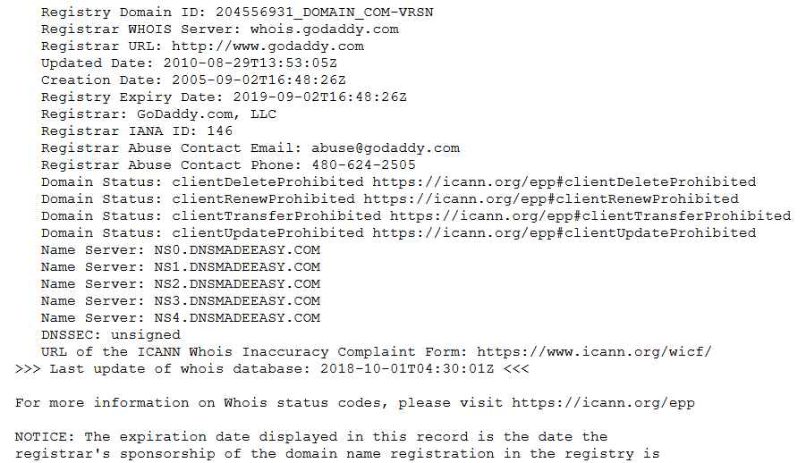
Whois
Used to gather contact names, DNS information, other data
Notes:
This is a sample one, that has been cropped down.

Slide 12
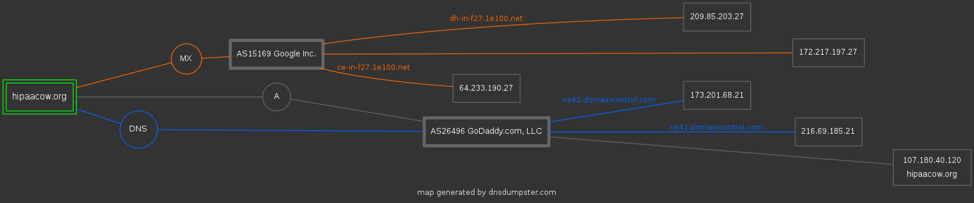
DNS Dumpster

Slide 13
LinkedIn data
Burp Suite has an extension that will just scrape Google’s crawling of LinkedIn sites
You’ll get the output quick, and it can be parsed into Excel very quick as well.
Notes:
I ran this and it was really fast. It captures it as you browse, and creates the output in a consumable fashion.

Slide 14
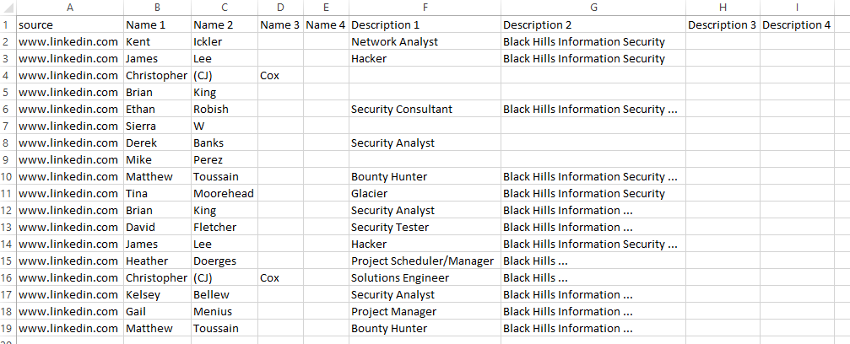
LinkedIn data

Slide 15
Level up the OSINT
Starts to get a little creative and creepy
Carsowners.net
Let’s search Google for site:carsowners.net “Jon Read”
Look at the results
It gives us: Type of car he drives, address, phone number, and VIN.
Can pivot and start searching by phone number, or address, or VIN.
Notes:
I ran this and it was really fast. It captures it as you browse, and creates the output in a consumable fashion.

Slide 16
Getting cree.py
Cree.py is an OSINT geolocation tool. It can pull from Flickr, Google+, Instagram, and Twitter
Good feature is to search by location, to within 100 meters, and list users that have posted from there.
Search the GPS location of your target, and start getting a list of twitter users from there.
Pivot, pivot, pivot.
Notes:
I ran this and it was really fast. It captures it as you browse, and creates the output in a consumable fashion.

Slide 17
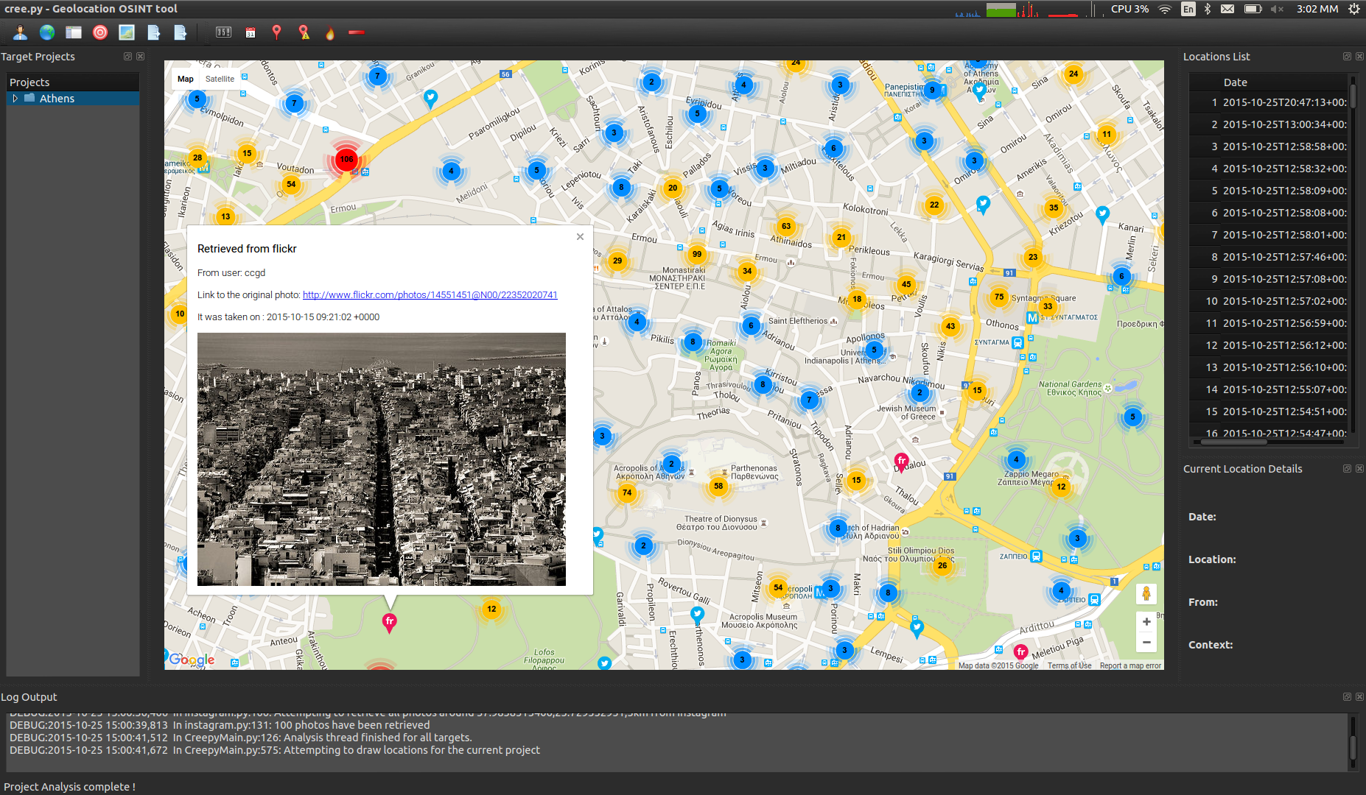
Getting cree.py

Slide 18
Many more sources
Such a very long list.
WI Circuit Court Access
PowerMeta
FOCA (Fingerprinting Online Collected Archives)
Twitter Advanced Search

Slide 19
Shodan
This is basically the Google of service banners
Attackers can ask Shodan for a list ftp banners, or telnet, and results will display.
Can also search by IP range, hostname…things from previous recon
Example: cisco net:“216.219.143.0/24”

Slide 20
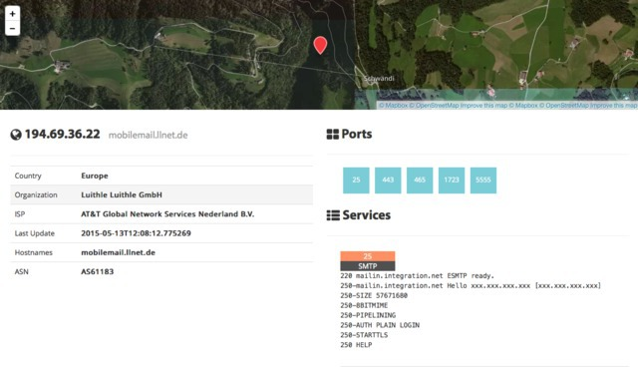
Shodan
Notes:
A little blurry on purpose

Slide 21
PunkSpider
Such a very long list.
WI Circuit Court Access
PowerMeta
FOCA
Twitter Advanced Search

Slide 22
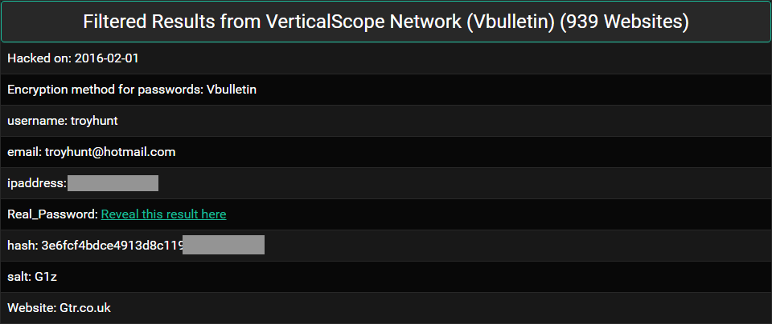
Leakedsource
Notes:
When you can reveal the passwords, unhashed, it is significant. That password is burned. Also goes back to why you might want to crack passwords. IP address is also a significant pivot point, and something that can be searched.

Slide 23
Leakedsource

Slide 24
Whoops.
Notes:
Yes, the site is back up, just moved to a different name.

Slide 25
Defensive review
Ensure publicly available into about your organization is accurate.
Conduct your own recon
Request inaccurate or damaging information be removed from sources
This may be near impossible to compel someone to remove the information.

Slide 26
Pager Capture
Transitioning to a source of information that attackers are leveraging.
This is concerning to me
I’m wanting to let you all know how simple it is.
Even though it is using really old technology.

Slide 27
Pager Capture
Aiming to do a little bit of demo
However some things have been modified to not be live/obscure
I don’t desire to display live data, because I don’t want to run the risk of displaying patient data, SSNs, etc.
I’ve introduced some noise on purpose.
Remember, attackers don’t play fair.

Slide 28
Software-Defined Radio
Using some inexpensive receivers (they work for as low as $20)
And FREE software, in SDR# and PDW
You can receive live pages over the air, display them on screen, or capture in a log to put together later
Let’s do a demo

Slide 29
SDR Sharp
Set up and tune to the pager frequency
Capture and relay that audio to a decoder program (PDW in this case).
Note: This is not on protected bands (like cellular) and it is decoding, not breaking encryption.

Slide 30
SDR Sharp
Set up and tune to the pager frequency
Capture and relay that audio to a decoder program (PDW in this case).
Note: This is not on protected bands (like cellular) and it is decoding, not breaking encryption.

Slide 31
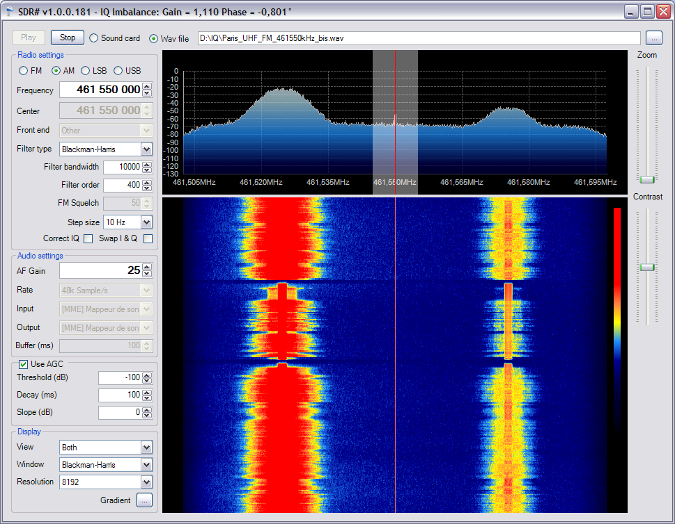
SDR Sharp

Slide 32
SDR Sharp
What sort of things have I seen:
SSNs in clear text
Patients and mental states
Patients on their way in, ambulance page-ahead
Patients under arrest, and tazed.
Should look at some sample results, either provided by external contacts, some live data here, or screenshots.

Slide 33
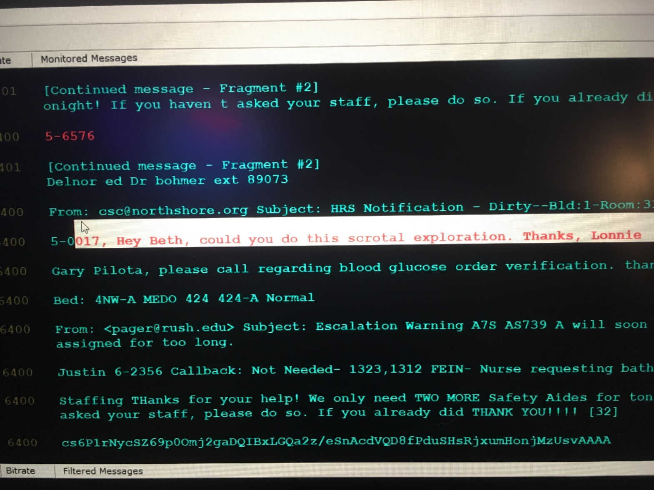
Pager Capture Results
Notes:
Sometimes it bluntly captures information that you don’t want to leak out of your organization.

Slide 34
Conclusions
Some soapbox
Wizards impressing other wizards
Does this look compliant to you?
Defensive Review
Questions

